Slide 1
Operating Systems
Chapter 7(b)
Deadlocks
Dr. Hammad Afzal
hammad.afzal@mcs.edu.pk
Department of Computer Software Engineering
National University of Sciences and Technology

Slide 2
Chapter 7: Deadlocks
Deadlock Avoidance

Slide 3
Deadlock Avoidance
Deadlock Prevention: Low system utilization, low system throughput
Deadlock Avoidance:
A decision is made dynamically whether the current resource allocation request will, if granted, potentially lead to a deadlock
Requires knowledge of future process requests
Notes:
Deadlock avoidance allows the three necessary conditions
but makes judicious choices to assure that the deadlock point is never reached.
Avoidance allows more concurrency than prevention.
With deadlock avoidance, a decision is made dynamically whether the current resource allocation request will, if granted, potentially lead to a deadlock.
Deadlock avoidance requires knowledge of future process resource requests.

Slide 4
Deadlock Avoidance
Requires that the system has some additional a priori information available.
For example, system knows that process P will require disk and then printer, whereas process Q will require printer and than disk.
Each request requires that in making the decision the system consider the resources currently available, the resources currently allocated to each process and future requests and releases of each process.

Slide 5
Two Approaches to Deadlock Avoidance
Process Initiation Denial
Do not start a process if its demands might lead to deadlock
Resource Allocation Denial
Do not grant an incremental resource request to a process if this allocation might lead to deadlock

Slide 6
Deadlock Avoidance
Various algorithms that use this approach differ in amount and type of information required.
Simplest and most useful model requires that each process declare the maximum number of resources of each type that it may need
The deadlock-avoidance algorithm dynamically examines the resource-allocation state to ensure that there can never be a circular-wait condition
Resource-allocation state is defined by the number of available and allocated resources, and the maximum demands of the processes

Slide 7
Safe State
When a process requests an available resource, system must decide if immediate allocation leaves the system in a safe state:
Safe State:
If system can allocate resources to each process (up to its maximum) in some order and still avoid deadlock.

Slide 8
Safe State
System is in safe state
if there exists a sequence <P₁, P₂, …, P_{n}> of ALL the processes in the systems
such that for each P_{i}, the resources that P_{i} can still request can be satisfied by currently available resources + resources held by all the P_{j}, with j < i
That is:
If P_{i} resource needs are not immediately available, then P_{i} can wait until all P_{j} have finished
When P_{j} is finished, P_{i} can obtain needed resources, execute, return allocated resources, and terminate
When P_{i} terminates, P_{i +1} can obtain its needed resources, and so on

Slide 9
Basic Facts
If a system is in safe state ⇒ no deadlocks
If a system is in unsafe state ⇒ possibility of deadlock
Avoidance ⇒ ensure that a system will never enter an unsafe state.

Slide 10
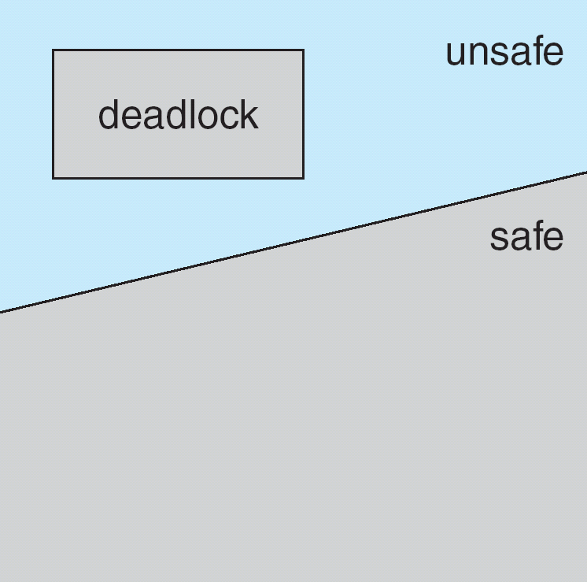
Safe, Unsafe, Deadlock State

Slide 11
Avoidance algorithms
 | Max Needs | Current Needs
P0 | 10 | 5
P1 | 4 | 2
P2 | 9 | 2
System has 12 Magnetic disks.
At time t0, system is in safe state
<P1,P0,P2>
At time t1, P2 requests and is allocated one more drive.
System can go in unsafe state
Hence, if a process requests a resource that is currently available, the system can decide whether resources should be allocated immediately or process must wait

Slide 12
Avoidance algorithms
Single instance of a resource type
Use a resource-allocation graph
Multiple instances of a resource type
Use the banker’s algorithm

Slide 13
Resource-Allocation Graph Scheme
Claim edge P_{i} → R_{j} indicate that process P_{j} may request resource R_{j}; in future, represented by a dashed line
Claim edge converts to request edge when a process requests a resource
Request edge converted to an assignment edge when the resource is allocated to the process
When a resource is released by a process, assignment edge reconverts to a claim edge
Resources must be claimed a priori in the system.
All claim edges for a process should be in graph before it starts executing.

Slide 14
Resource-Allocation Graph Algorithm
Suppose that process P_{i} requests a resource R_{j}
The request can be granted only if converting the request edge to an assignment edge does not result in the formation of a cycle in the resource allocation graph

Slide 15
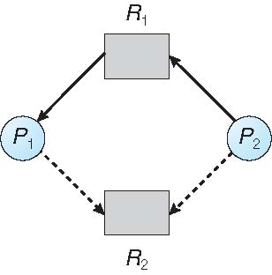
Resource-Allocation Graph

Slide 16
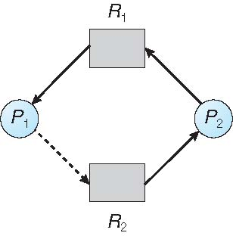
Unsafe State In Resource-Allocation Graph

Slide 17
Banker’s algorithm from William Stalling’s Book

Slide 18
Process Initiation Denial
A process is only started if the maximum claim of all current processes plus those of the new process can be met.
Not optimal,
Assumes the worst: that all processes will make their maximum claims together.
Notes:
A process is only started if the maximum claim of all current processes plus those of the new process can be met.
This strategy is hardly optimal, because it assumes the worst:
that all processes will make their maximum claims together.

Slide 19
Resource Allocation Denial
Referred to as the banker’s algorithm
A strategy of resource allocation denial
Consider a system with fixed number of resources
State of the system is the current allocation of resources to process
Safe state is where there is at least one sequence that does not result in deadlock
Unsafe state is a state that is not safe
Notes:
Movie button goes to http://gaia.ecs.csus.edu/~zhangd/oscal/Banker/Banker.html

Slide 20
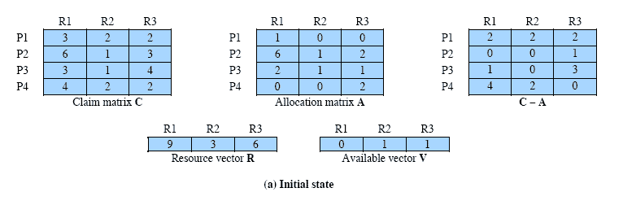
Determination of Safe State
Resources available after allocation
Amount of Existing Resources
Notes:
Animation: Callouts explain resource parts of figure
This figure shows the state of a system consisting of four processes and three resources.
Total amount of resources
R1 = 9
R2 = 3
R3 = 6
In the current state allocations have been made to the four processes, leaving available
1 unit of R2
1 unit of R3
Is this a safe state?
To answer this question, we ask an intermediate question:
Can any of the four processes be run to completion with the resources available?
That is, can the difference between the maximum requirement and current allocation for any process be met with the available resources?

Slide 21
Process i
C_{ij} - A_{ij} ≤ V_{j}, for all j
This is not possible for P1,
which has only 1 unit of R1 and requires 2 more units of R1, 2 units of R2, and 2 units of R3.
If we assign one unit of R3 to process P2,
Then P2 has its maximum required resources allocated and can run to completion and return resources to ‘available’ pool

Slide 22
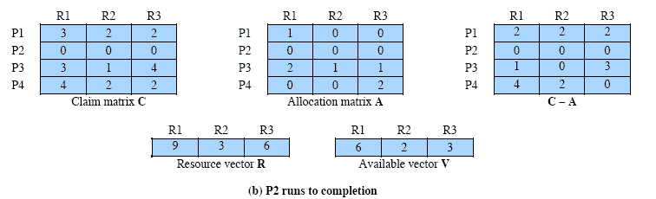
After P2 runs to completion
Can any of the remaining processes can be completed?
Note P2 is completed
Notes:
In this case, each of the remaining processes could be completed as shown on the next slides

Slide 23
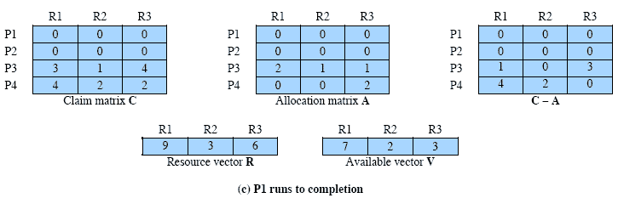
After P1 completes
Notes:
Suppose we choose P1,
allocate the required resources,
complete P1,
and return all of P1’s resources to the available pool.
We are left in the state shown in Figure 6.7c on this slide

Slide 24
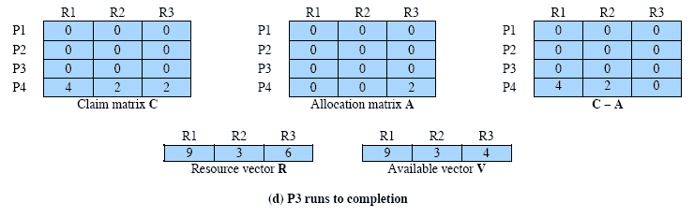
P3 Completes
Thus, the state defined originally is a safe state.
Notes:
P3 completes, resulting in the state of Figure 6.7d shown on this slide
Finally, we can complete P4. At this point, all of the processes have been run to completion.
Thus, the state defined by Figure 6.7a is a safe state.

Slide 25
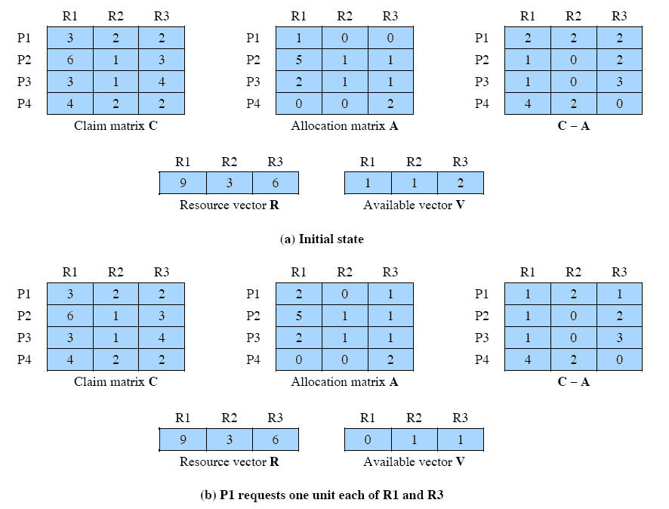
Determination of an Unsafe State
This time Suppose that P1 makes the request for one additional unit each of R1 and R3.
Is this safe?
Notes:
Suppose that P1 makes the request for one additional unit each of R1 and R3; if we assume that the request is granted,
Is this a safe state?
No,
because each process will need at least one additional unit of R1, and there are none available.
Thus, on the basis of deadlock avoidance, the request by P1 should be denied and P1 should be blocked.
NOTE: This is not a deadlocked state.
It merely has the potential for deadlock.
It is possible, for example, that if P1 were run from this state it would subsequently release one unit of R1 and one unit of R3 prior to needing these resources again.
If that happened, the system would return to a safe state.
Thus, the deadlock avoidance strategy does not predict deadlock with certainty; it merely anticipates the possibility of deadlock and assures that there is never such a possibility.

Slide 26
Deadlock Avoidance Strategy
When a process makes a request for a set of resources,
assume that the request is granted,
Update the system state accordingly,
Then determine if the result is a safe state.
If so, grant the request and,
if not, block the process until it is safe to grant the request.
Notes:
This suggests the following deadlock avoidance strategy,
which ensures that the system of processes and resources is always in a safe state.
When a process makes a request for a set of resources, assume that the request is granted, update
the system state accordingly, and then determine if the result is a safe state. If so,
grant the request and, if not, block the process until it is safe to grant the request.

Slide 27
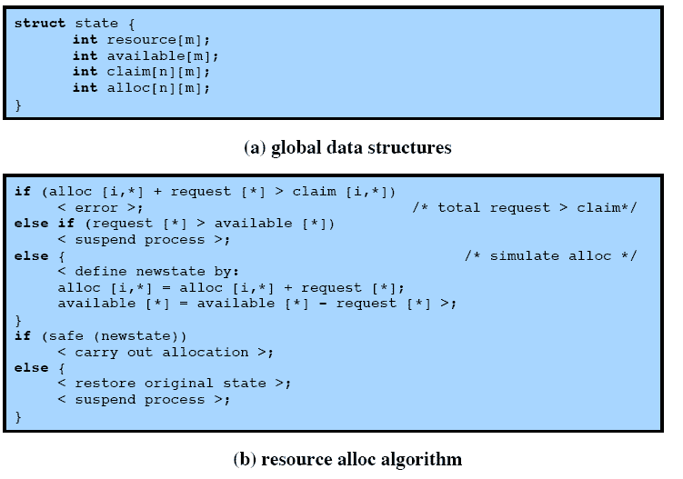
Deadlock Avoidance Logic
Notes:
This slide gives an abstract version of the deadlock avoidance logic.
The main algorithm is shown in part (b).
With the state of the system defined by the data structure state, request[*] is a vector defining the resources requested by process i.
First, a check is made to assure that the request does not exceed the original claim of the process.
If the request is valid, the next step is to determine if it is possible to fulfill the request (i.e., there are sufficient resources available).
If it is not possible, then the process is suspended.
If it is possible, the final step is to determine if it is safe to fulfill the request. To do this, the resources are tentatively assigned to process i to form newstate.

Slide 28
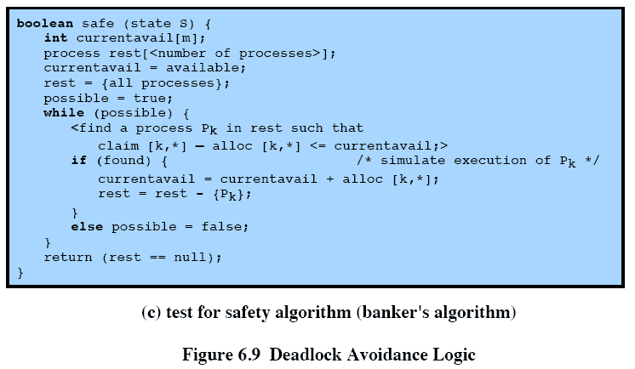
Deadlock Avoidance Logic
Notes:
Then a test for safety is made using the algorithm in Figure 6.9c.

Slide 29
Deadlock Avoidance Advantages
It is not necessary to pre-empt and rollback processes, as in deadlock detection,
It is less restrictive than deadlock prevention.
Notes:
Deadlock avoidance has the advantage that it is not necessary to preempt and
rollback processes, as in deadlock detection, and is less restrictive than deadlock
prevention.

Slide 30
Deadlock Avoidance Restrictions
Maximum resource requirement must be stated in advance
Processes under consideration must be independent and with no synchronization requirements
There must be a fixed number of resources to allocate
No process may exit while holding resources
Notes:
However, it does have a number of restrictions on its use:
• The maximum resource requirement for each process must be stated in advance.
• The processes under consideration must be independent;
that is, the order in which they execute must be unconstrained by any synchronization requirements.
• There must be a fixed number of resources to allocate.
• No process may exit while holding resources.

